Slide 1
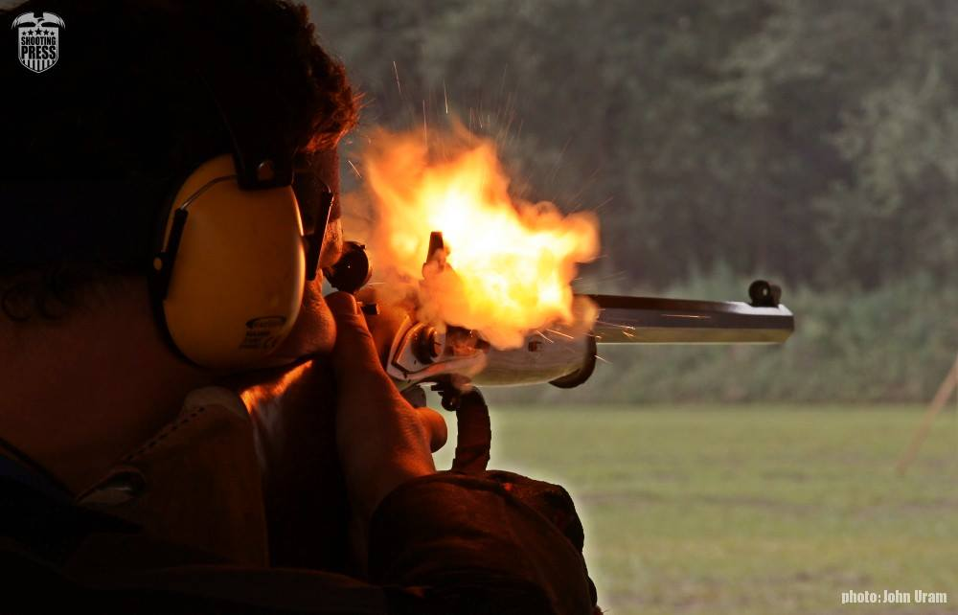
2019 MLAIC European
Championships
10-17th August 2019
HUNGARY Sarlóspuszta

Slide 2
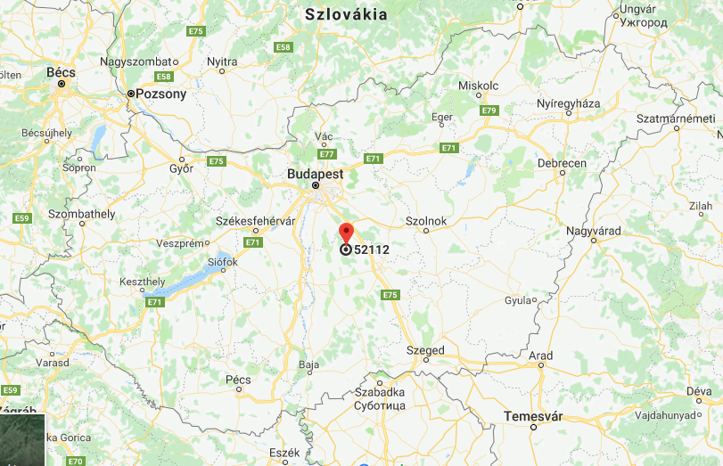

Slide 3
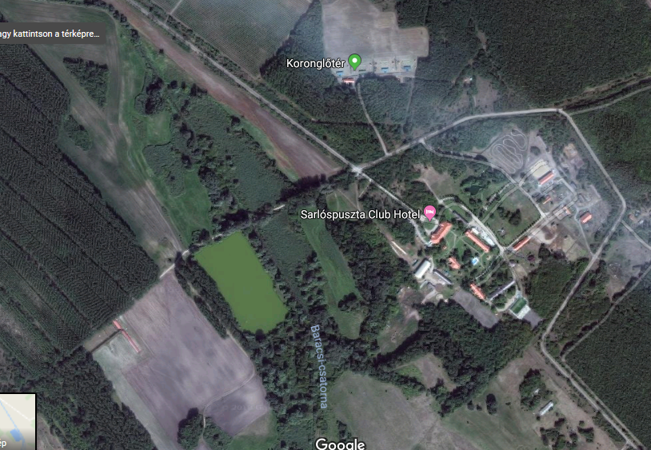

Slide 4
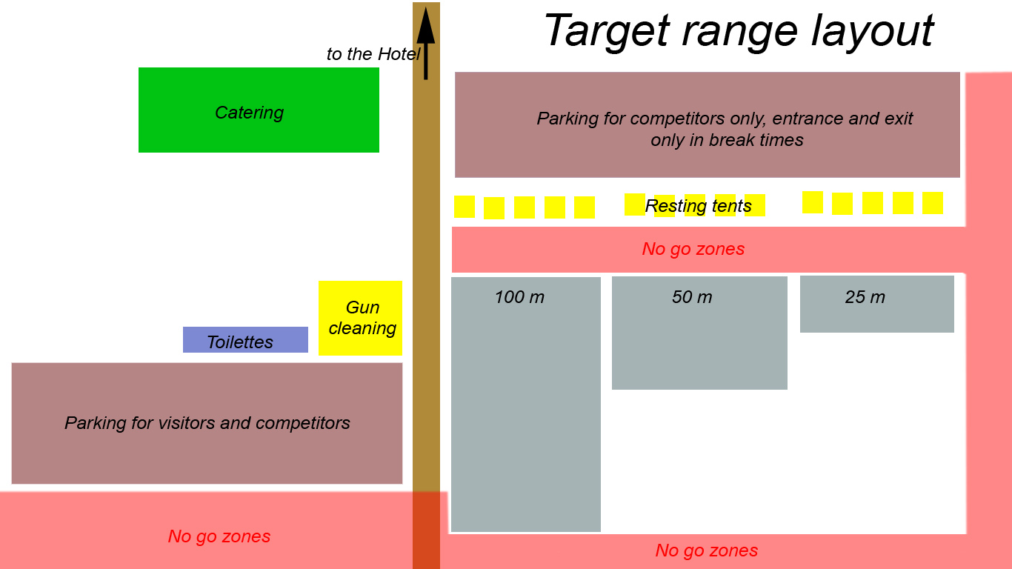

Slide 5
Registration fees
Registration: 90 EUR
Target disciplines: 30 EUR
Clay target disciplines: 40 EUR
Closing banquet: 60 EUR
Team competition: 40 EUR
Firearms storage: 15 EUR
Insurance (optional): 15 EUR

Slide 6
Hotel, accomodation
http://welltravel.hu/
EC subpage to be launched in
Sept 2018

Slide 7
Time schedules
WellTrave subpage Sept 2018
Championship subpage Dec 2018
Preliminary registration April 2019
Final registration June 2019
First day of practice 10 Aug 2019
Departure day 18 Aug 2019

Slide 8
Disciplines
All MLAIC approved single and team disciplines
Optional extra:
Historical:
Leipzig
Gettysburg
Battle of the nations clay shooting cup (last day)
Hungarian national:
Paterson
Berdan
Trapper

